Slide 1
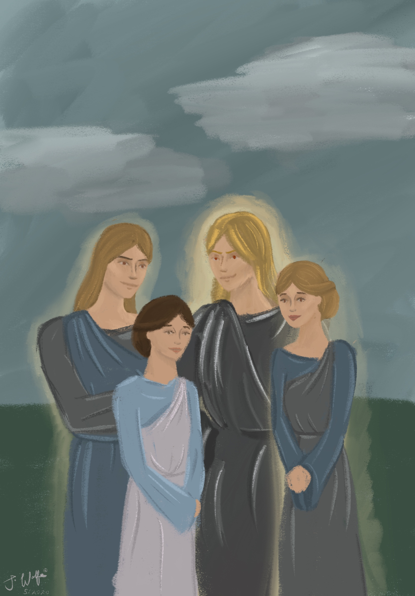
The Angelic Infiltration
(Part Two: Genesis 6:10-13)
Davao, 25-26 Aug 2024
Teacher: Tim McLachlan

Slide 2
The conference videos which accompany this
slide show may be found here:
https://www.ibdoctrine.org/angelic-infiltration
For further information please contact Pastor Tim at:
sawokproductions@yahoo.com

Slide 3
Genesis 6:10
Noah became the father of three sons; Shem, Ham and Japheth.

Slide 4
Genesis 6:11
“And the earth was corrupt before God, and the earth was filled with unrighteousness.”
But NOT like this, as presented in the Sunday School classes....

Slide 5
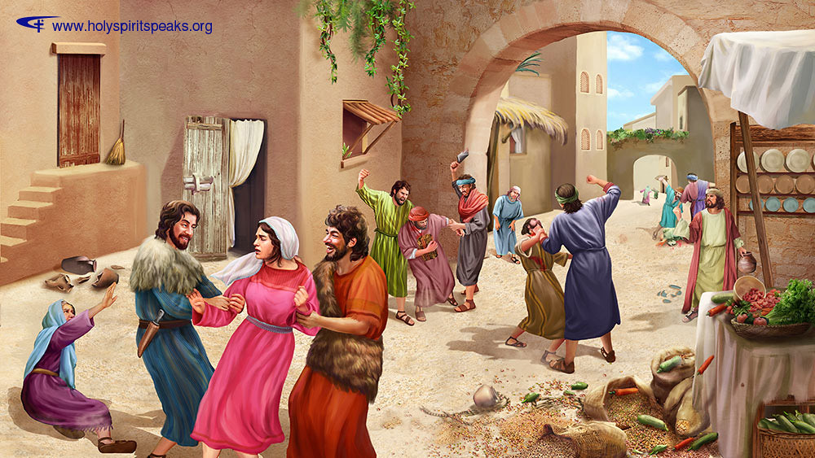
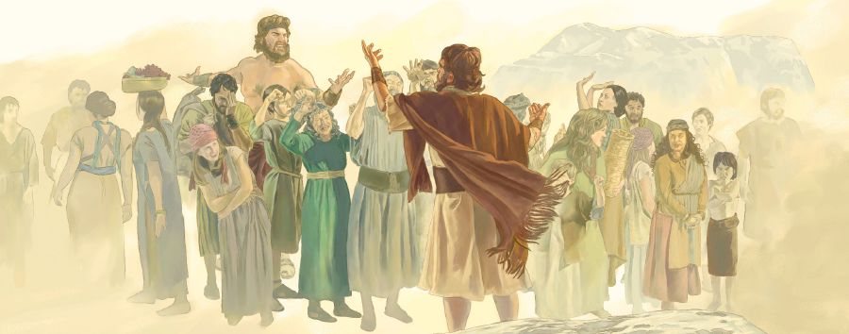

Slide 6
Genesis 6:11
“And [wav consecutive, continuation from previous events]
the earth [reference to living beings – there were almost no humans now [vs. 13] earth now refers to Nephilim]
had corrupted itself [Niphil imperf. of shachat]
before God [with reference to the divine decree]
and the earth was filled with unrighteousness/wrongdoing [chamas / LXX- adikias].”

Slide 7
Genesis 6:11
“And [wav consecutive, continuation from previous events] the earth [reference to living beings – there were no humans now [vs. 13] earth now refers to Nephilim] was corrupt [Niphil imperf. of shacat] had become corrupted] before God, and the earth was filled with unrighteousness [chamas / LXX- adikias].”

Slide 8
Mat 24:37 But as the days of Noah were, so shall be the coming of the Son of Man.
Mat 24:38 For as in the days before the flood, they were eating and drinking, marrying and giving in marriage, until the day Noah entered into the ark.

Slide 9
^{LUKE 17:26-30}
²⁶ And just as it happened in the days of Noah, so it will be also in the days of the Son of Man:²⁷ they were eating, they were drinking, they were marrying, they were being given in marriage, until the day that Noah entered the ark, and the flood came and destroyed them all.^{28 [r]}It was the same as happened in the days of Lot: they were eating, they were drinking, they were buying, they were selling, they were planting, they were building;²⁹ but on the day that Lot went out from Sodom it rained fire and ^{[s]}brimstone from heaven and destroyed them all.³⁰ It will be ^{[t]}just the same on the day that the Son of Man is revealed.³¹

Slide 10
Genesis 6:12
And God looked upon the earth. And, behold, it had corrupted itself [Hiphil reflexive]! For all flesh [reference to original humans] had corrupted it’s way upon the earth.
Summary: Because the people of the cosmos had chosen to corrupt its way (by becoming involved with the angels) therefore they too were corrupt (no pure humans left upon the earth. )
Gen 6:13

Slide 11
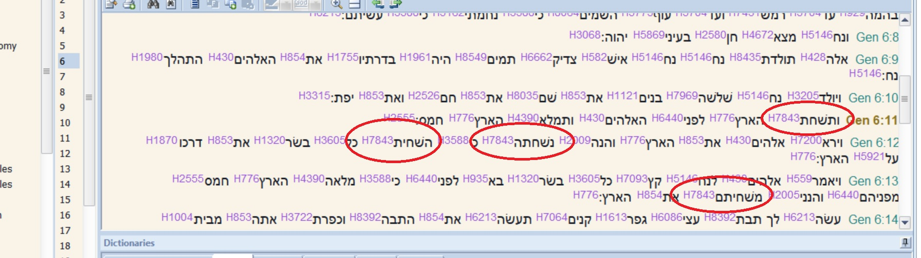
Genesis 6:11-13 The Word תחשׁ “Shachath”

Slide 12
Gen. 6:11 Niphal Imperfect = was being corrupted
Gen 6:12 (first use) Niphal perfect (of the feminine noun / 'ha aretz') = the earth was already corrupted
Gen 6:12 (second use) Hiphil [causative/active] perfect (of the masculine singular noun / 'cal basar' ), = all flesh had corrupted its way
Gen 6:13 Hiphil [causative/active] = I (God) will destroy them with the earth

Slide 13
סמח = chamas [chamas / LXX- αδικιας / adikias].
(Gen 16:5) And Sarai said to Abram, My wrongdoing [chamas / adikios be upon you.]
(Deut 19:16) ענה חמס (chamas anar) false witness / μάρτυς ἄδικος (LXX)
(Isaiah 53:9) (MKJV) And He put His grave with the wicked, and with a rich one in His death; although He had done no violence, nor was any deceit in His mouth.
(1 John 1:9) ‘He will cleanse us from all αδικιας” (emphasis exact form as in LXX Gen 6:11)

Slide 14
Gen 6:12
And God looked upon the earth. And, behold, it was corrupted! For all flesh [basah] had corrupted its way [derek] upon the earth.

Slide 15
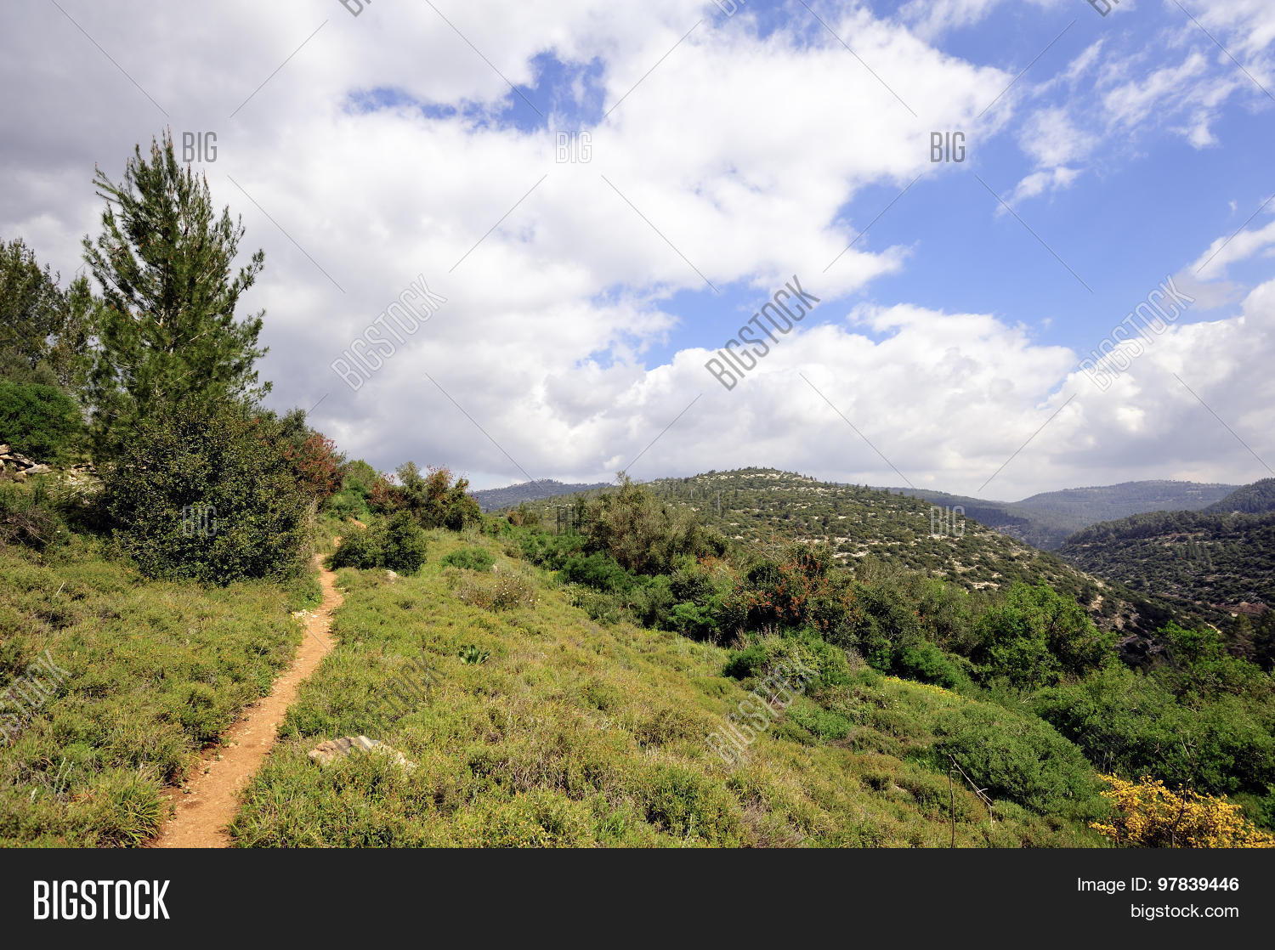
Psalms 23:3
'paths of righteousness'

Slide 16
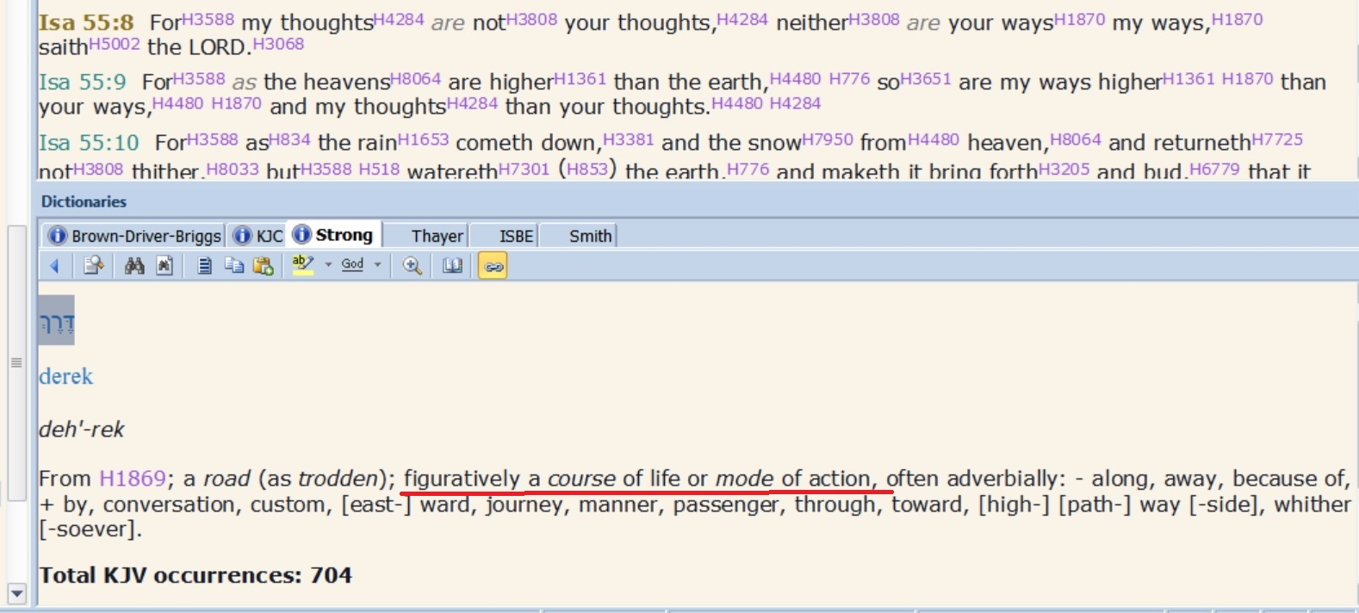

Slide 17
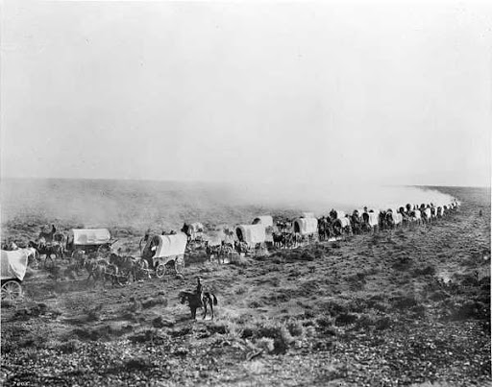
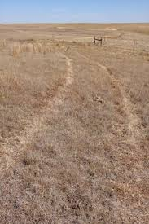

Slide 18
“Facilitating wheeltracks of righteousness”
Creating/Developing the habit of thinking 'God's way' not 'the my way highway'

Slide 19
Isa 55:8 For My thoughts are not your thoughts, nor your ways My ways, says Jehovah.
Isa 55:9 For as the heavens are higher than the earth, so are My ways higher than your ways, and My thoughts than your thoughts.

Slide 20
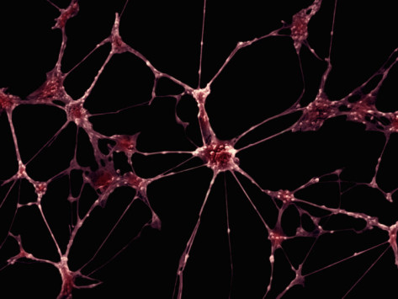
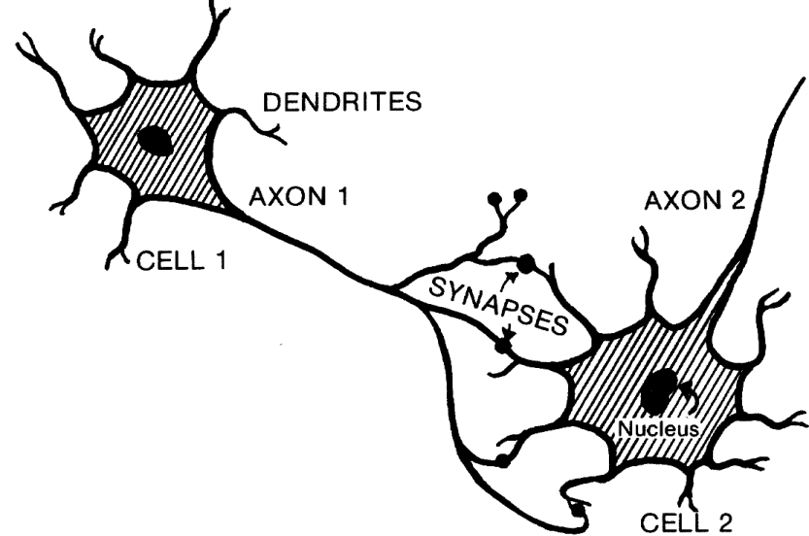

Slide 21
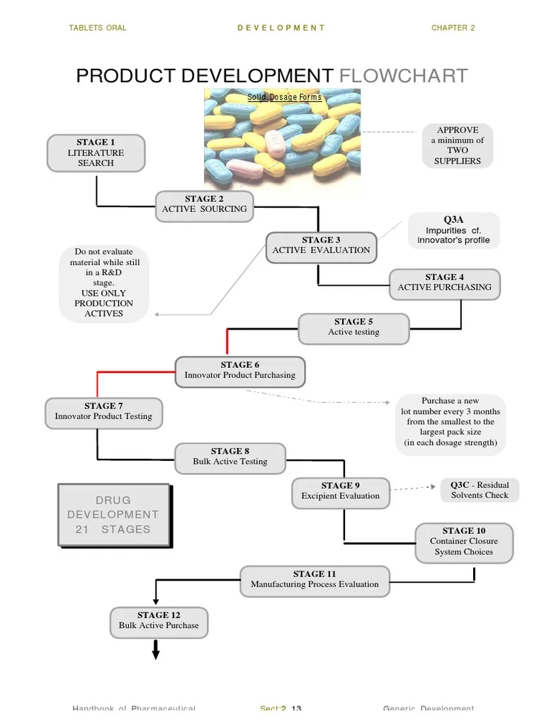

Slide 22
John 14:6
(MKJV) Jesus said to him, I am the Way, the Truth, and the Life; no one comes to the Father but by Me.

Slide 23
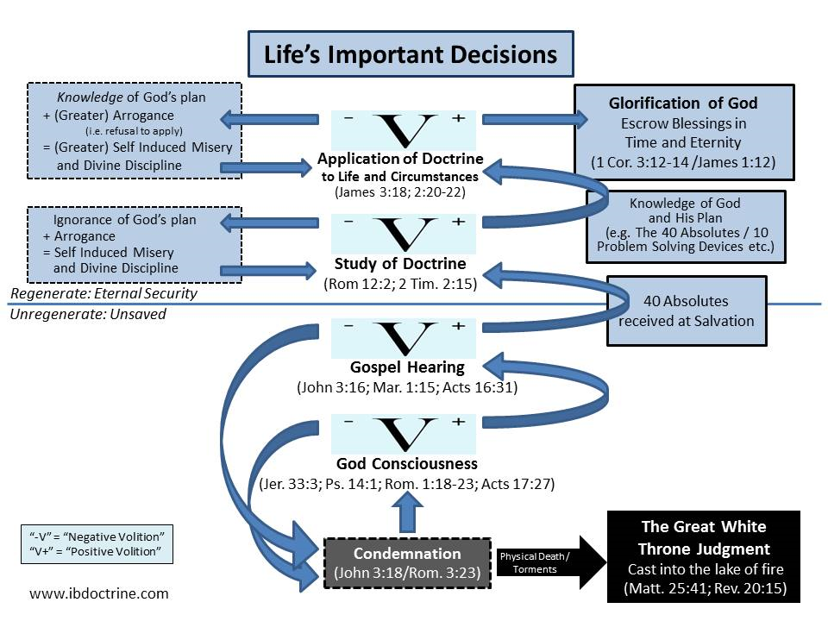

Slide 24
Gen 6:12 (second use) Hiphil [causative/active] perfect (of the masculine singular noun / 'cal basar' ), = all flesh had corrupted its way upon the earth

Slide 25
Gen 6:13
And God said to Noah, The end of all flesh [basah] has come before Me, for the earth is filled with unrighteousness [chamas] through them. And, behold, I will destroy them with the earth [ha aretz].

