Slide 1

Taught by Tim McLachlan,
Based on the teachings of
R.B.Thieme, Jr.

Slide 2
The Angelic Conflict refers to the prehistoric creatures in opposition to and revolt against God.
The revolt began with the arrogance of Lucifer, and continues today as both angels and humans continue to rebel against God.

Slide 3
The first creature to revolt against God was the most perfect creature God ever made. He was called Lucifer. (Hebrew of Isaiah 14:12 gives his full name:
“הילל בן שׁחר / Halel, ben Shakar”
“Bright star, son of the morning”)

Slide 4
In Isaiah 14:13-14 Lucifer said five proclamations, concluding with “I will be like the Most High.”
This began his revolt against God and the prehistoric Angelic Conflict, led by Lucifer/ Satan.

Slide 5
Isa 14:13 For you have said in your heart, I will go up to the heavens, I will exalt my throne above the stars of God; I will also sit on the mount of the congregation, in the sides of the north. Isa 14:14 I will go up above the heights of the clouds; I will be like the Most High.

Slide 6
One third of the angels decided to join Satan,
Rev 12:4.
When all angels had made their decisions for God or for Satan, a courtroom trial was convened in heaven, and Satan was found guilty of rebellion and sentenced to the Lake of Fire.

Slide 7
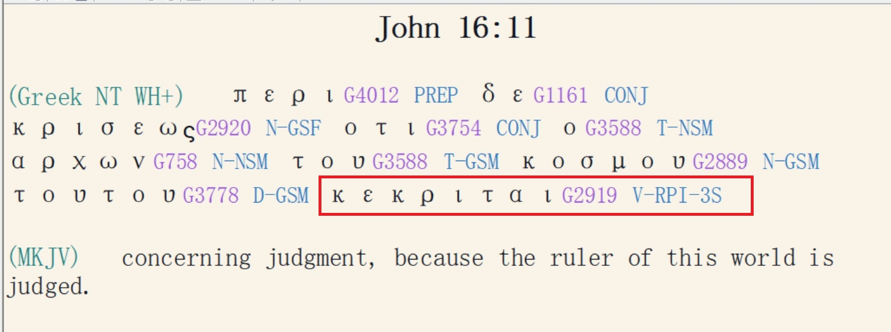
At this trial Lucifer/Satan was sentenced to the Lake of Fire (Matthew 25:41; John 16:11

Slide 8
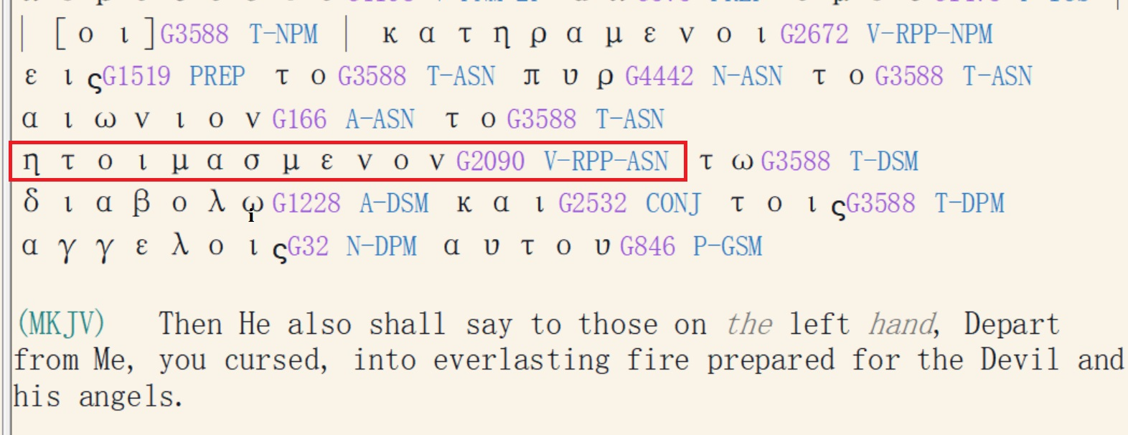
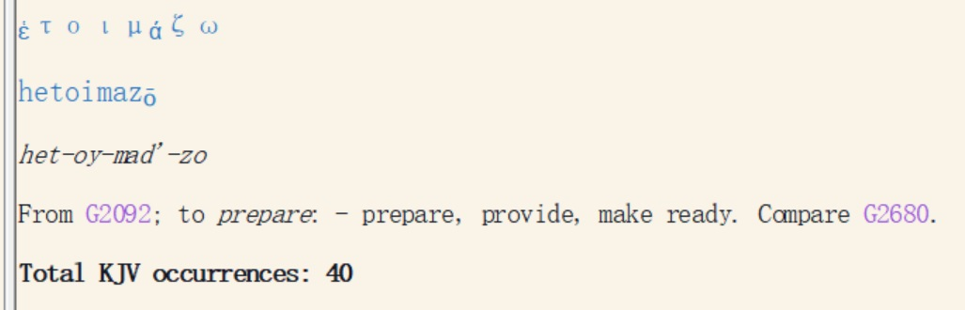
Matthew 25:41

Slide 9
Now we are in the phase of “The Angelic Appeal Trial” which is considered as the legal part of the Angelic
Conflict.

Slide 10
As in any trial there is a judge (God the Father), defendants (Satan and the fallen angels), and witnesses (humans, beginning with Adam.) There are rules (which God reveals to us in the Bible), there is a courtroom (the High Court of Heaven) and the witness platform (planet earth), and there is a verdict and punishment for wrong doing.

Slide 11
As a result of the prehistoric trial, two categories of angels emerged.
1. Elect angels. They are called “holy” in Mark 8:38, and “elect” in 1 Tim 5:21. They are a category of angels who will live with God forever. They are “saved” (never sinned), and they will never get thrown into the Lake of Fire.
(2) Fallen angels which have two categories:

Slide 12
A) Fallen Angels in prison (“Tartarus”) because they broke the rules of the trial (2 Peter 2:4; Jude 6.)
This relates to the fallen angels having relationships with human women, leading to the flood of Noah (Gen. Chap. 6)
B) Fallen Angels still in operation, i.e. demons,
Psa 8:4-5; Heb 2:6-7; 2 Peter 2:11. Mark 5;
1 Cor 10:20-21.
Their doctrines (false teaching) are mentioned in 1 Tim 4:1.

Slide 13
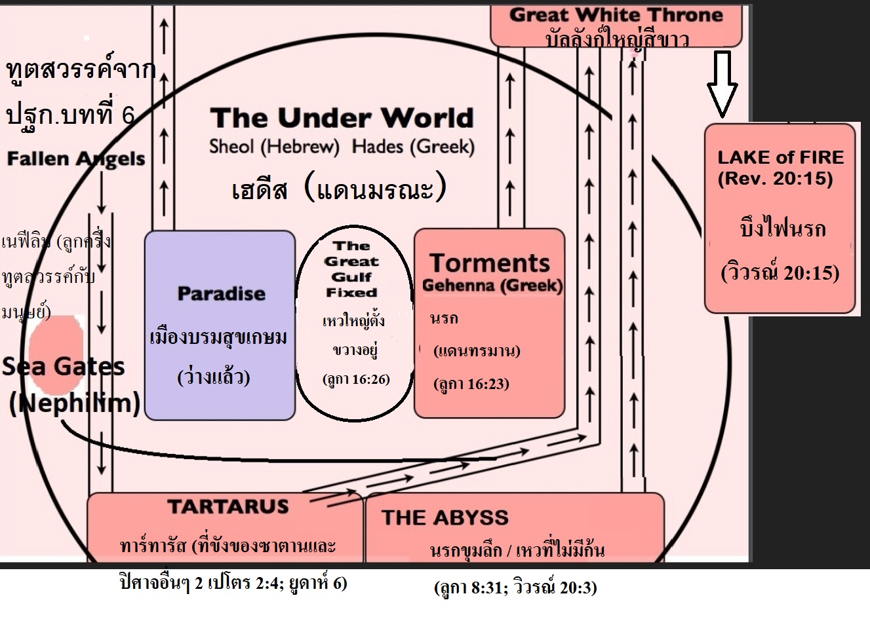

Slide 14
Therefore, the Angelic Conflict refers to the prehistoric creatures lead by Satan who came under opposition to and revolted against God.
The Angelic Conflict began in eternity past, after the creation of the universe and before the restoration of planet earth in Gen 1:2f,
(Gen. 1:1; Job 38:7; Is. 45:18;
Recommended reading:
‘Creation, Chaos and Restoration’ by R.B.Thieme, Jr.

Slide 15
The revolt began with arrogance, bringing forth a combination of sins, Isa 14:12-23; Ezek 28:11-19.
Arrogance [disobedience to authority] is the root sin of all other sins.
Satan is guilty of a plethora of sins: arrogance, blasphemy, lying, deception, murder, etc.

Slide 16
As a Result of Their Rebellion,
God Sentenced Them to the Lake of Fire.
Mat 25:41 tells us that the Lake of Fire was created for them.

Slide 17
Satan, as the Chief of the Fallen Angels, Appealed the Case, at the time of the sentence to the Lake of Fire, which God (the judge of the trial) granted.

Slide 18
Satan is the lawyer and defence attorney for the appeal. “Satan” (Hebrew) and “Diabolos” (Greek) means “adversary” or “slanderer” particularly in a legal context. It also means, “a lawyer who takes the case.”

Slide 19
In objecting to the sentence, Satan made his appeal by impugning (blaspheming) the character of God.
He said the judge, God, was not fair. How can a loving God throw His creatures into the Lake of Fire? So, in every way he impugned the character of God.

Slide 20
In this way, Satan demanded an appeal: That God would reconsider His original verdict of “guilty.”
We know Satan appealed because God sentenced Satan and the fallen angels to the Lake of Fire even before human history (Matthew 25:41; John 16:11) but they will not go in the fire until human history is finished. (Revelation 20:10)
Note in Rev. 20:10 Lucifer and the angels are thrown into the lake of fire without further trial, unlike humans who are judged individually (Rev. 20:11-15). This is because Lucifer was already judged BEFORE human history.

Slide 21
God, as judge, granted Satan an Appeal trial. The way God is going to win the appeal trial is to create something with a lower mental and physical capacity, yet still with the same soul structure

Slide 22
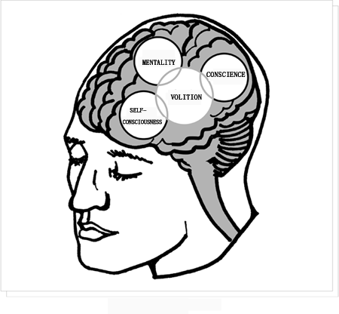
Souls of angels have the same four components that we have: self-consciousness, mentality, conscience, and volition.)

Slide 23

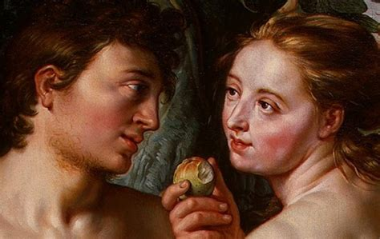
Genesis 3:1-6; Hosea 6:7; 1 Timothy 2:14

Slide 24
The first witness was Adam, but because he failed to be obedient to God (he failed the test),
God had to allow for more witnesses to be born
(Gen. 2:16, 17; Hosea 6:7; Romans 5:14; 1 Corinthians 15:22).

Slide 25
(From the Word File ST144 by Tim McLachlan)
How to Glorify God: Evidence testing
(Pre-requisite reading: Christian Suffering Chap. 10; Doctrines related to the Angelic Conflict / The Appeal Trial of Satan)
1.Evidence testing is a legal procedure, and parallels the judicial system found in most courtrooms. Any complete trial consists of the following elements:

Slide 26
1.1 A case : The angelic appeal trial, whereby Satan appeals God's sentencing to the Lake of Fire, and attempts to prove that both God and God's sentence is unjust. (Isa. 14:13-14; Ezek. 28:16; Matt. 25:41)
1.2 A judge and prosecuting attorney: God the Father (Ps. 9:7; Eccl. 12:1)
1.3 A defense attorney and defendant : Satan, representing himself (Zech. 3:1;Rev. 12:10): The titles ‘Satan’ (Hebrew) and ‘Diabolis’ (Greek, translated ‘devil’) are not names for Lucifer, but descriptive terms which mean ‘accuser’, ‘slanderer’, or ‘adversary’. See Angelology

Slide 27
1.4 Witnesses: The scriptures record many examples of witnesses, those who were tested regarding their faithfulness to God and His Word. Some obvious examples:
- Adam and Eve (failed), leading to the necessary perpetuation of the human race.
- Abraham (passed: the test of being obedient to God to the point of sacrificing his own son (Heb. 11:17), after which he received the appellation 'friend of God' (James 2:23)
- Job (passed through all phases after setbacks)
- Joshua the high priest (Zech 3:1 , the outcome is not revealed in scripture)
- The humanity of the Lord Jesus Christ (Matt. 4; this passage proves that the applied word of God, not miracles, provides the power to defeat Satan in his cross-examination of the witness.)

Slide 28
1.5 An advocate : The Lord Jesus Christ stands as an advocate for all believers. Should the mature believer stumble while undergoing cross-examination by the defense attorney (Satan) he can be assured that by naming his sins to God the Father (1 Jn. 1:9) the Lord (Jesus Christ) will testify to his purified status, that he might take the witness stand again (Zech. 3:1-4).
“My little children, I am writing these things to you so that you may not sin. And if anyone sins, we have an advocate [παρακλητος / parakletos] with the Father, Jesus Christ the righteous.” (1 Jn. 2:1)
Liddel and Scott’s Greek-English Lexicon (1974) : “παρακλητος (parakletos) 1. Adjective of parakaleo, called to one’s aid, especially in a court of justice. Latin: advocatus, an advocate.”

Slide 29
1.6 A testing ground / witness stand : Planet earth, called ‘cosmos’ : Satan's comic system. (Eph. 2:2; Rom. 12:2; see also ‘The Doctrine of the Cosmic System’. When Adam failed in his responsibility as the original witness by eating the forbidden fruit, he relinquished his rulership of the world to Satan (Gen. 1:26, 28; 2 Cor. 4:4).
However, even though we are born into Satan’s cosmic system and with a sin nature, every man has the opportunity (based on free will) to respond to God’s plan and to glorify Him by becoming a successful witness in the Appeal Trial of Satan.
1 Cor. 4:9 reveals how the mature believer is placed on the witness stand to testify to the faithfulness of God.

Slide 30
1 Cor. 4:9 reveals how the mature believer is placed on the witness stand to testify to the faithfulness of God:
“For I [Paul] think God has exhibited us apostles [in this instance Paul, Apollo and Cephas (1 Cor. 3:22)] last, as men appointed [condemned] to death, because we have become a spectacle [θεατρον / theatron] to the world [a reference to Satan as the ruler of the world and lead defense attorney], to angels [both elect and fallen angels have a keen interest in the historic extension of Satan’s appeal.]” ( 1 Cor. 4:9 )

Slide 31
Contact Tim McLachlan at: sawokproductions@yahoo.com
Website: www.ibdoctrine.org

