Slide 1
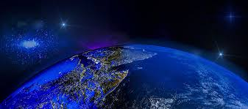
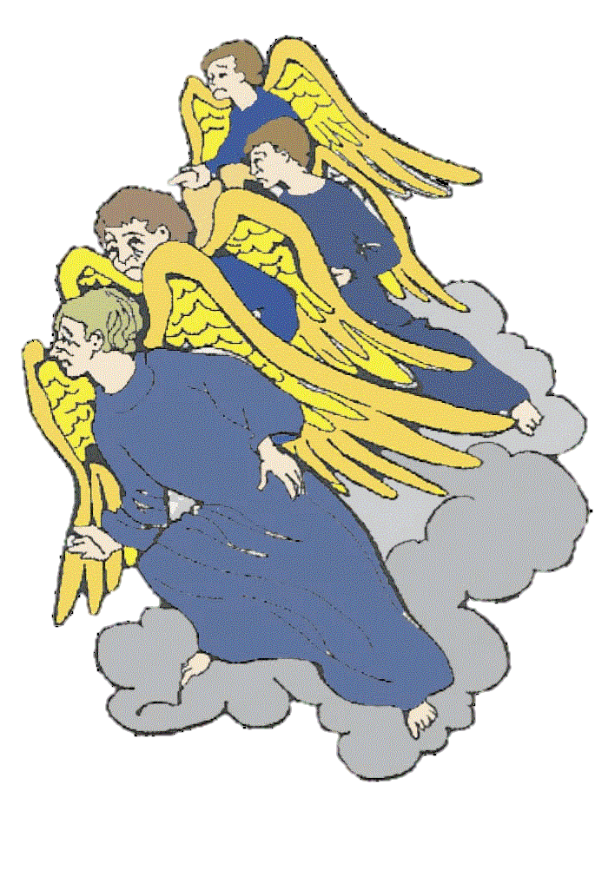
The Show the
ANGELS Watch

Slide 2
The Show the Angels Watch

Slide 3
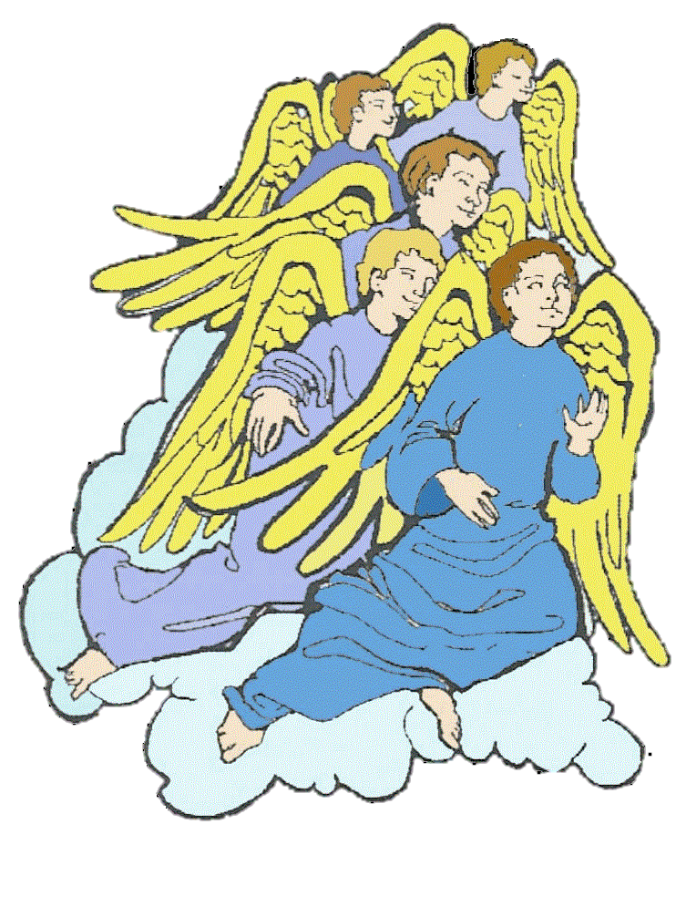
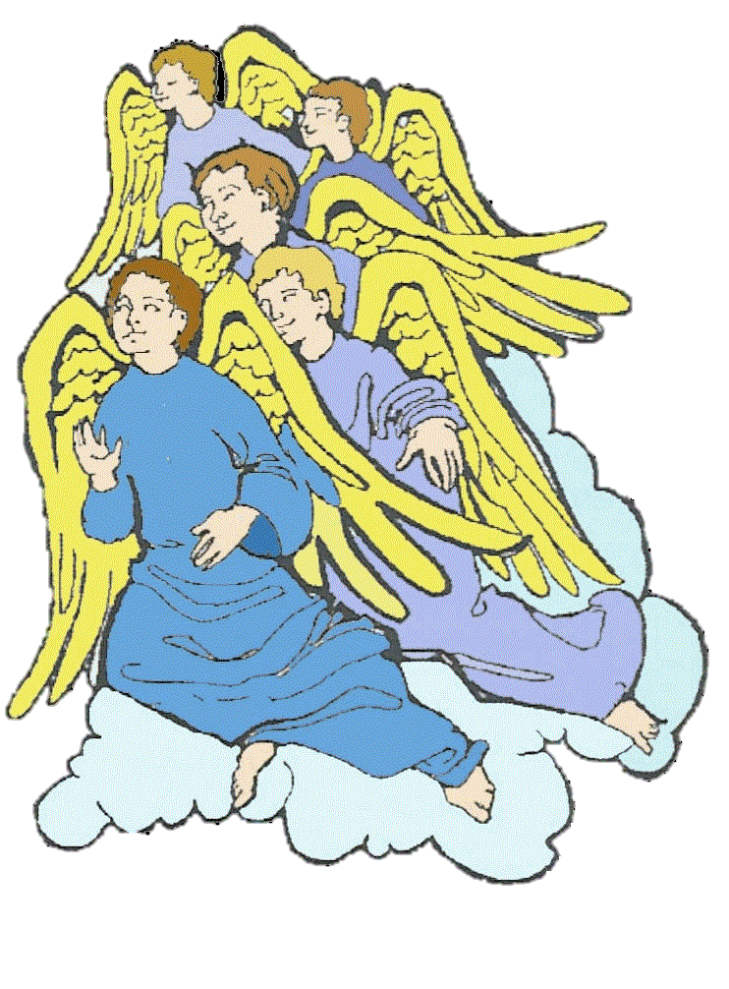
Before God created people on the Earth, He created
an uncountable number of ANGELS.
“For in Him all things were created: things in heaven and on earth, visible and invisible…”
Col. 1:16a
Notes:
Creation of Angels

Slide 4
God gave all the angels
beauty
and intelligence
and power
and VOLITION,
the freedom to choose.

Slide 5
The angels looked around heaven at everything God had given to them.
Everything was PERFECT!
They sang and shouted with joy!
“When the morning stars sang together and all the angels shouted for joy” Job 38:7

Slide 6
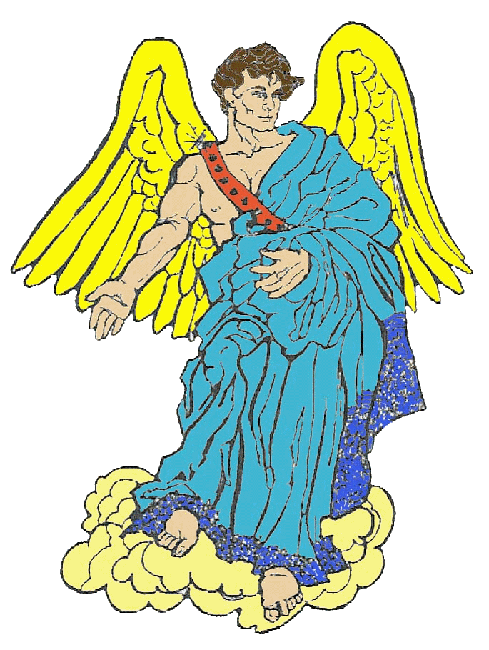
But God already knew that Lucifer, the most powerful angel, would start trouble.
Lucifer chose to be unhappy.
He became proud and envious of God’s power.
Five times he said NO to God.

Slide 7
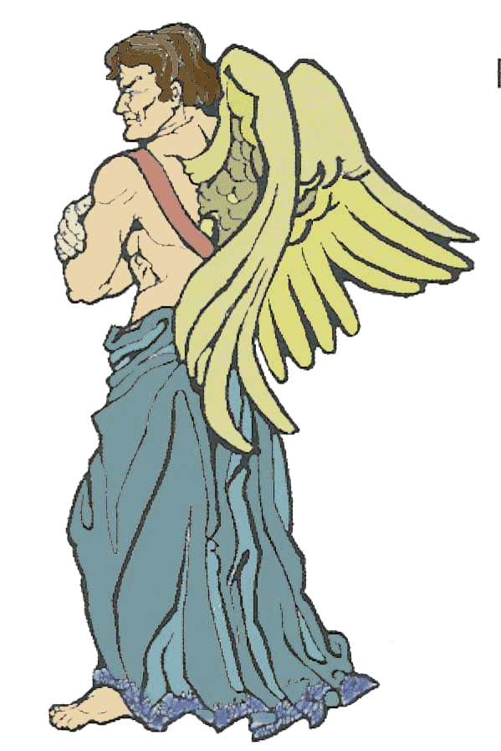
In his pride and envy, Lucifer said,
“I will make myself like the Most High.” Isaiah 14:14
Making himself like God would be impossible. It was a LIE.
Notes:
Satan says he will be like the Most High- a LIE

Slide 8
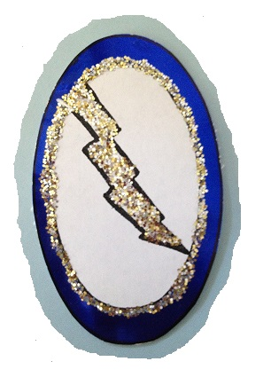
Lucifer was not OMNIPOTENT like God is. He could never be as powerful as God. He could never make angels, as God had made him.

Slide 9
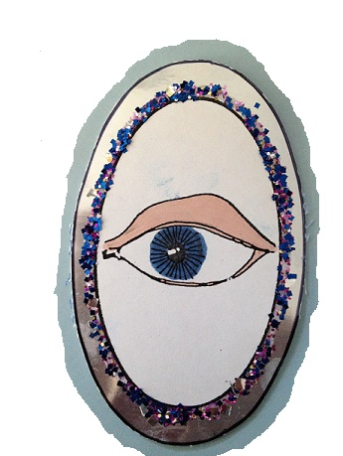
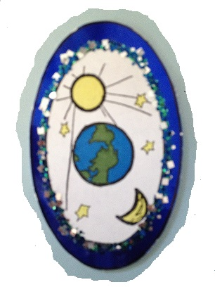
Lucifer could never be OMNIPRESENT. He could only be in one place at a time.
Lucifer could never be OMNISCIENT. He did not know what God was thinking, but God knew what Lucifer was thinking.

Slide 10
Lucifer’s PRIDE started a war against God, so Lucifer could not keep his job of guarding God’s throne.
Lucifer had become SATAN, God’s enemy.
“Your heart was lifted up because of your beauty; you corrupted your wisdom by reason of your splendor.. I cast you to the ground” Ezekiel 28:17a

Slide 11
Satan did not stop. He told his lies to other angels.
One third of the angels chose Satan’s lies instead of God and VERACITY, or Truth. They became enemies of God too, called demons.

Slide 12
God knew that Satan and the demons would not change their minds.
They were all cast down from heaven. And they would be punished. Satan was angry.
“You were internally filled with violence and you sinned; therefore, I have cast you as profane from the mountain of God” Ezekiel 28:16

Slide 13
Satan did not think God was showing LOVE.
That was another lie.
But God already had a plan to show His love even more.
“God is Love…” I John 4:16b

Slide 14
God had a show for the angels to watch.
God fixed up the Earth and created the first people, Adam and Eve, on it.

Slide 15
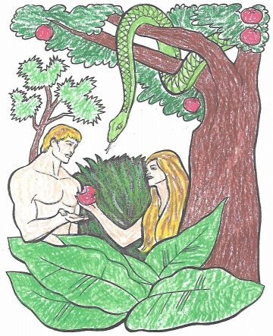
The angels watched Satan make more trouble.
Satan indwelled a serpent and told lies to Eve.
He was glad when Adam and Eve disobeyed God and got in trouble. He didn’t really care about love.
“...And the woman said,’The serpent deceived me, and I ate.’” Gen. 3:13b

Slide 16
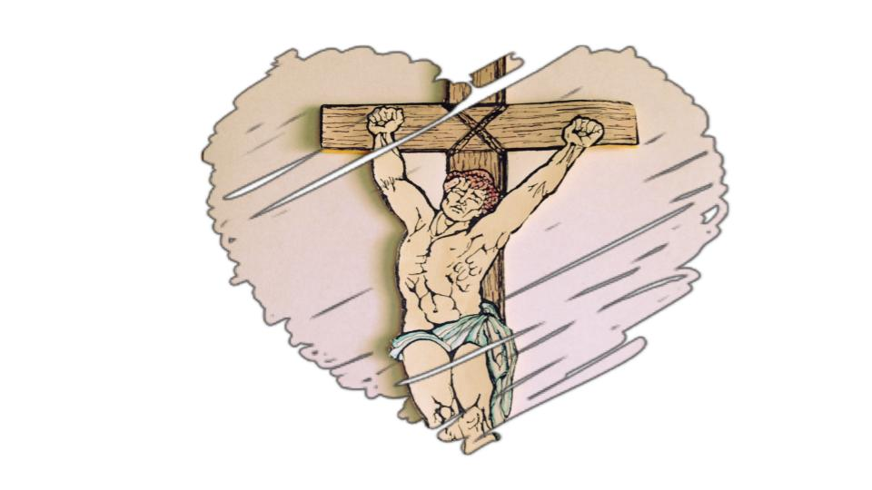
God told Adam and Eve that He had a plan to help them. He promised Adam and
Eve that He would send a SAVIOR.
God told them He could fix the problem of their sin if they believed in the Savior. They did!

Slide 17
Satan wanted to stop the SAVIOR from being born, but he could not. He tried more trouble and more lies, but he was not Omnipotent.
He was going to lose.

Slide 18
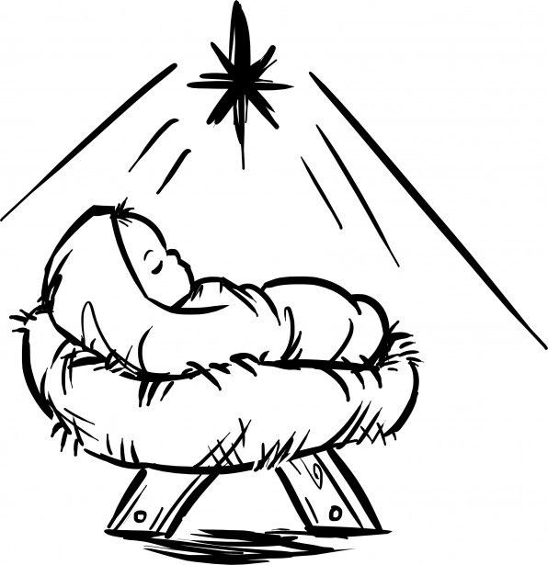
When The SAVIOR, the Lord Jesus Christ, was born into the world, the angels on God’s side sang and cheered.
“...multitudes of the heavenly host praising God and saying, ‘Glory to God in the highest…” Luke 2:13

Slide 19
The angels saw God show His
The Lord Jesus Christ paid for EVERYONE’s sins on the Cross. So anyone can believe on Him and live with God in heaven forever.
Satan and the demons lost! They are still lying and causing trouble, but God will punish them at the right time.
“... into the eternal fire which has been prepared for the devil and his angels” Matthew 25:41

Slide 20
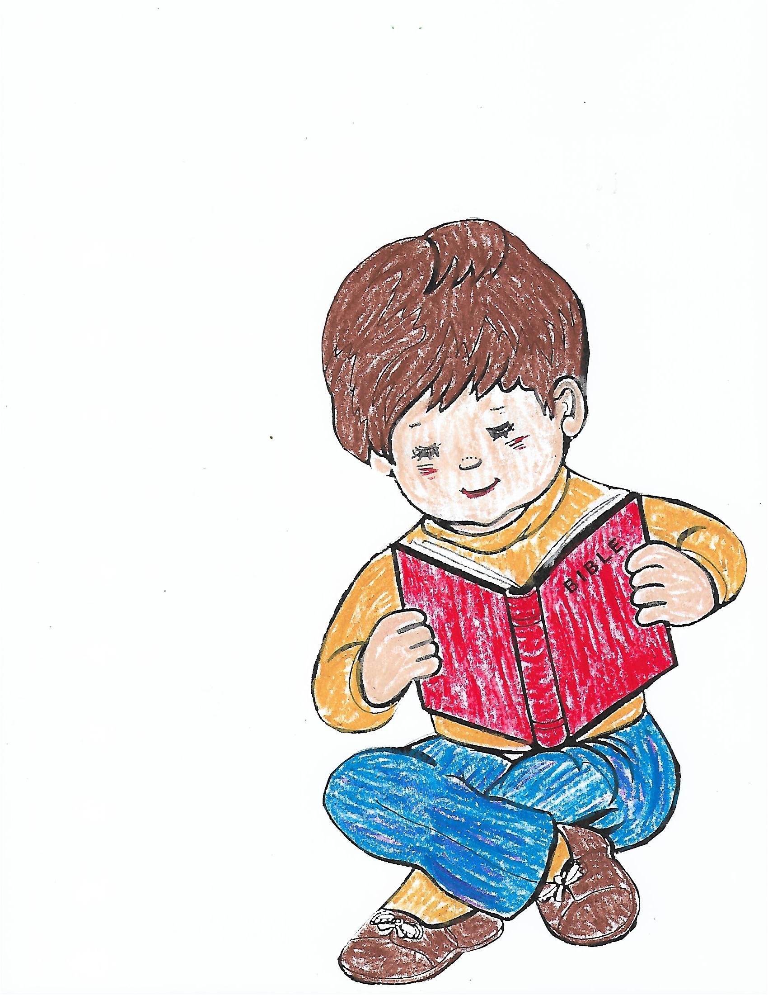
The angels are still watching. The angels on God’s side cheer when anyone believes in the Lord Jesus Christ!
The angels look to see who will believe Satan’s lies and who will believe God’s TRUTH in His Word!
“...there is joy in the presence of the angels of God over one sinner who repents.” Luke 15:10

Slide 21
The Volition Song
I can choose. I can choose,
Yes or no. Yes or no.
Because I have freewill. I have freewill.
In my soul. In my soul.
VOLITION! VOLITION!
Dwells within my soul.
VOLITION! VOLITION!
Means I have control.
Just like Satan. Just like Satan.
[the angels]
Before time. Before time.
Grace or evil. Grace or evil.
The choice is mine. The choice is mine.
VOLITION! VOLITION!
Dwells within my soul.
VOLITION! VOLITION!
Means I have control.
Acknowledgements for visuals and content:
berachah.org
joegriffinmedia.org
rbthieme.org
Notes:
Volition Song Lyrics

