Slide 1
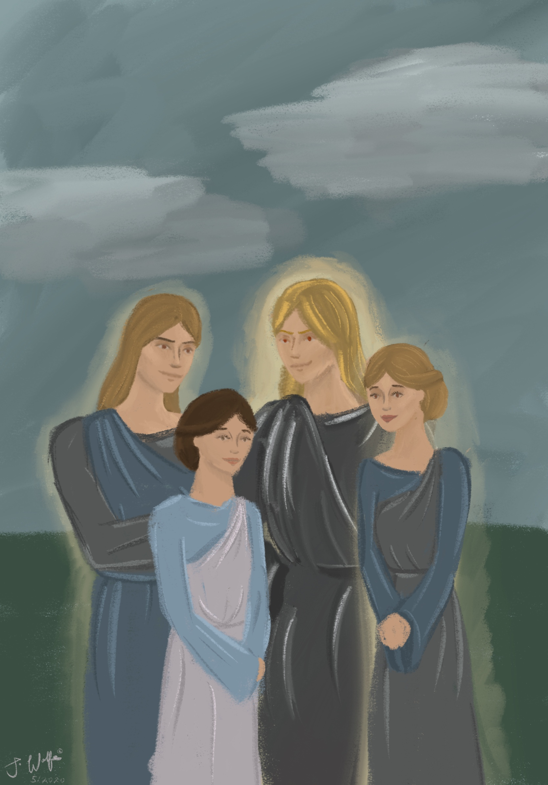
The Angelic Infiltration
(Part One: Genesis 6:1-13)
Davao, 25-26 Aug 2024
Teacher: Tim McLachlan

Slide 2
The conference videos which accompany this
slide show may be found here:
https://www.ibdoctrine.org/angelic-infiltration
For further information please contact Pastor Tim at:
sawokproductions@yahoo.com

Slide 3
Genesis 6:1-2
Now it came about when men began to multiply on the face of the land, and daughters were born to them, that the sons of God [ בני האלהים / bene ha elohim (cf. Job 1:6; 2:1; Job 38:7)] saw that the daughters of men [ בנות האדם / benot ha adam ] were beautiful; and they took wives for themselves, whomever they chose"

Slide 4
(Genesis 6:1-2)
Actually the word for "beautiful" here is [ טוב / tov - good] the same word that God uses as he restores the earth, completing the different categories of creation then pronouncing it 'good', meaning 'perfect', or 'complete'. (Gen. 1:10, 12, 18, 21, 25 and 31) This means perfect, without defect.
Compare with Gen. 12:11 (MKJV) And it happened, when he had come near to enter into Egypt, he said to Sarai his wife, Behold now, I know that you are a beautiful [ יפה / yâpheh ] woman to look upon.
Gen. 29:17 And Leah was weak of eyes, but Rachel was beautiful יפת תאר [yapheh to-ar - beautiful, comely].

Slide 5
Now, the word 'tov' can also mean to look beautiful in some cases, but were the angels really just interested in the woman because of a physical attraction?
Satan, as their ruler would have informed them that victory in the angelic appeal trial would require discrediting the judge, the one who passed sentence on the fallen angels (Matt. 25:41).
Satan would also have told them that one critical strategy to discredit God would be the infiltration of the genealogical line of the God-man, the 'seed of the woman' (Gen. 3:15). In doing so there would be no more 'pure' humans to continue the line, therefore no 'God-man', and no salvation for humankind.

Slide 6
'whomever they chose'. Question to the ladies: if you had to chose between a strong, intelligent, and very handsome angel, or a man, which would you chose?

Slide 7
Gen. 6:3 "Then the Lord said, "My Spirit shall not strive with man forever, for that he is also flesh; nevertheless his days shall be one hundred and twenty years."
This is the 120 year period of grace before judgment, where evangelism, under the convincing/convicting ministry of the Holy Spirit takes place (John 16:7-11). This is also referred to as 'common grace', the opportunity for all who are interested in salvation to hear the Gospel and understand it.
For any who hear the message and believe they then become the recipients of 'efficacious grace' whereby the Holy Spirit converts positive volition into salvation. In the church age this begins the very short moment in time process of the imputations and bestowing of the 40 absolutes. In the earlier dispensation of the Gentiles they did not receive 40 absolutes, though they would at least receive +R, eternal life, a human spirit, promises regarding resurrection etc.

Slide 8
As Noah is building the ark a typology of salvation is being built up. Noah and his family (apparently even Methuselah was alive up until just before the flood as well) would have given the Gospel message of FAICA to whoever was interested (man or nephilim), with the Holy Spirit acting as a human spirit in order that they might comprehend the spiritual information (Operation Z / 1 Cor. 2). To reject the Holy Spirit's work of common grace is the 'unpardonable sin':

Slide 9
Jesus speaking: "Therefore I say to you, every sin and blasphemy will be forgiven men, but the blasphemy against the Spirit will not be forgiven men. Anyone who speaks a word against the Son of Man, it will be forgiven him; but whoever speaks against the Holy Spirit, it will not be forgiven him, either in this age or in the age to come" (NKJV, emphasis added).
The Holy Spirit would specifically communicate to them; through the message of a man called Noah, (2Pe 2:5) Before the Flood, the Holy Spirit had a threefold ministry to the human race. First, He restrained sin so that the human race could survive. Had there been no restraint during that time, Noah and his family would have been slain. Second, the Holy Spirit’s ministry of conviction provided information in the unbeliever’s soulish mind so that he might make a decision necessary for salvation.

Slide 10
Genesis 6.4
" There were giants in the earth in those days. And also after that, when the sons of God came in to the daughters of men, and they bore to them, they were mighty men who existed of old, men of renown."

Slide 11
Genesis 6:4a
“There were giants [ הנפלים / ha nephilim - fallen ones] in the earth in those days. [the days of Noah].”
The Hebrew word nephalim means fallen ones.
They had fallen from the human race in that they were no longer true humanity.

Slide 12
Genesis 6:4b
“This was the cause: .... ”
Usually translated “also after that” because translators emphasize the single Hebrew word 'akree' (after). However, this translation does not make sense in any way, and there are actually four words here, a Hebrew idiom:
אשׁר כן אחרי וגם ve gam akrey ken asher

Slide 13
Genesis 6:4c
“the sons of God [fallen angels, ‘bene ha elohim’ Job 1:6, 2:1, 38:7]
came into [bo + subject + al = sons of God came into]
the daughters of men (ha adam: Technical term for ‘human being’ (Gen. 1:26; )
The 'sons of God' (also in Gen. 6:2) is a term used for all the angels (elect and fallen eg. Job 1:6; 2:1 and Job 38:7, where they are also called 'stars of the morning' ). However, in this context we know that this is speaking of fallen angels as they are trying to destroy the genealogical line of the humanity of Jesus Christ!

Slide 14
Genesis 6:4d
“and they [the women] gave birth [yalad, normal method of giving birth] to them [these fallen angels], the same [aforementioned nephilim, referring to 6:4a, the beginning of the paragraph] who became mighty ones [gibboreem – ‘might ones’ NOT ‘mighty men’]

Slide 15
Genesis 6:4e
which were of old [עלם – olam, forever, mythological status], individuals [אִישׁ/ ish, not ‘adam’] of renown.”
Difference between Adam and Ish: Adam is technical, referring more to the physical, human aspect– more like ‘human’ or just ‘male’ The word ‘Adam’ is related to ‘dam’ which means ‘red’ and ‘ha adamah’ the earth/soil. (Because he was created from the mineral elements found in the soil).
As a technical term ‘ האדם / ha adam (with the article) is ‘the man’ but in English Bibles they also use it to refer to Adam, the individual (translations are very inconsistent with this: For example the KJV will use the terms interchangeably throughout Gen. 2).

Slide 16
Genesis 6:4e
which were of old [עלם – olam, forever], men [אִישׁ/ eesh, not ‘adam’] of renown.”
Ish = husband and wife. “Ish” is even used for animals in Gen. 7:2, describing the ‘male (“eesh”) and his female (eeshah), emphasizing the relationship aspect.
Used for angels too (Dan 9:21 yes, while I was speaking in prayer, even the man (“eesh”) Gabriel),

Slide 17
(Genesis 6:4)
There were nephilim in the earth in those days. This was the cause: the sons of God came into the daughters of men and they [the women] gave birth to them [these fallen angels], the same [aforementioned nephilim] who became mighty ones, which were of old [forever, mythological], individuals of renown.”

Slide 18
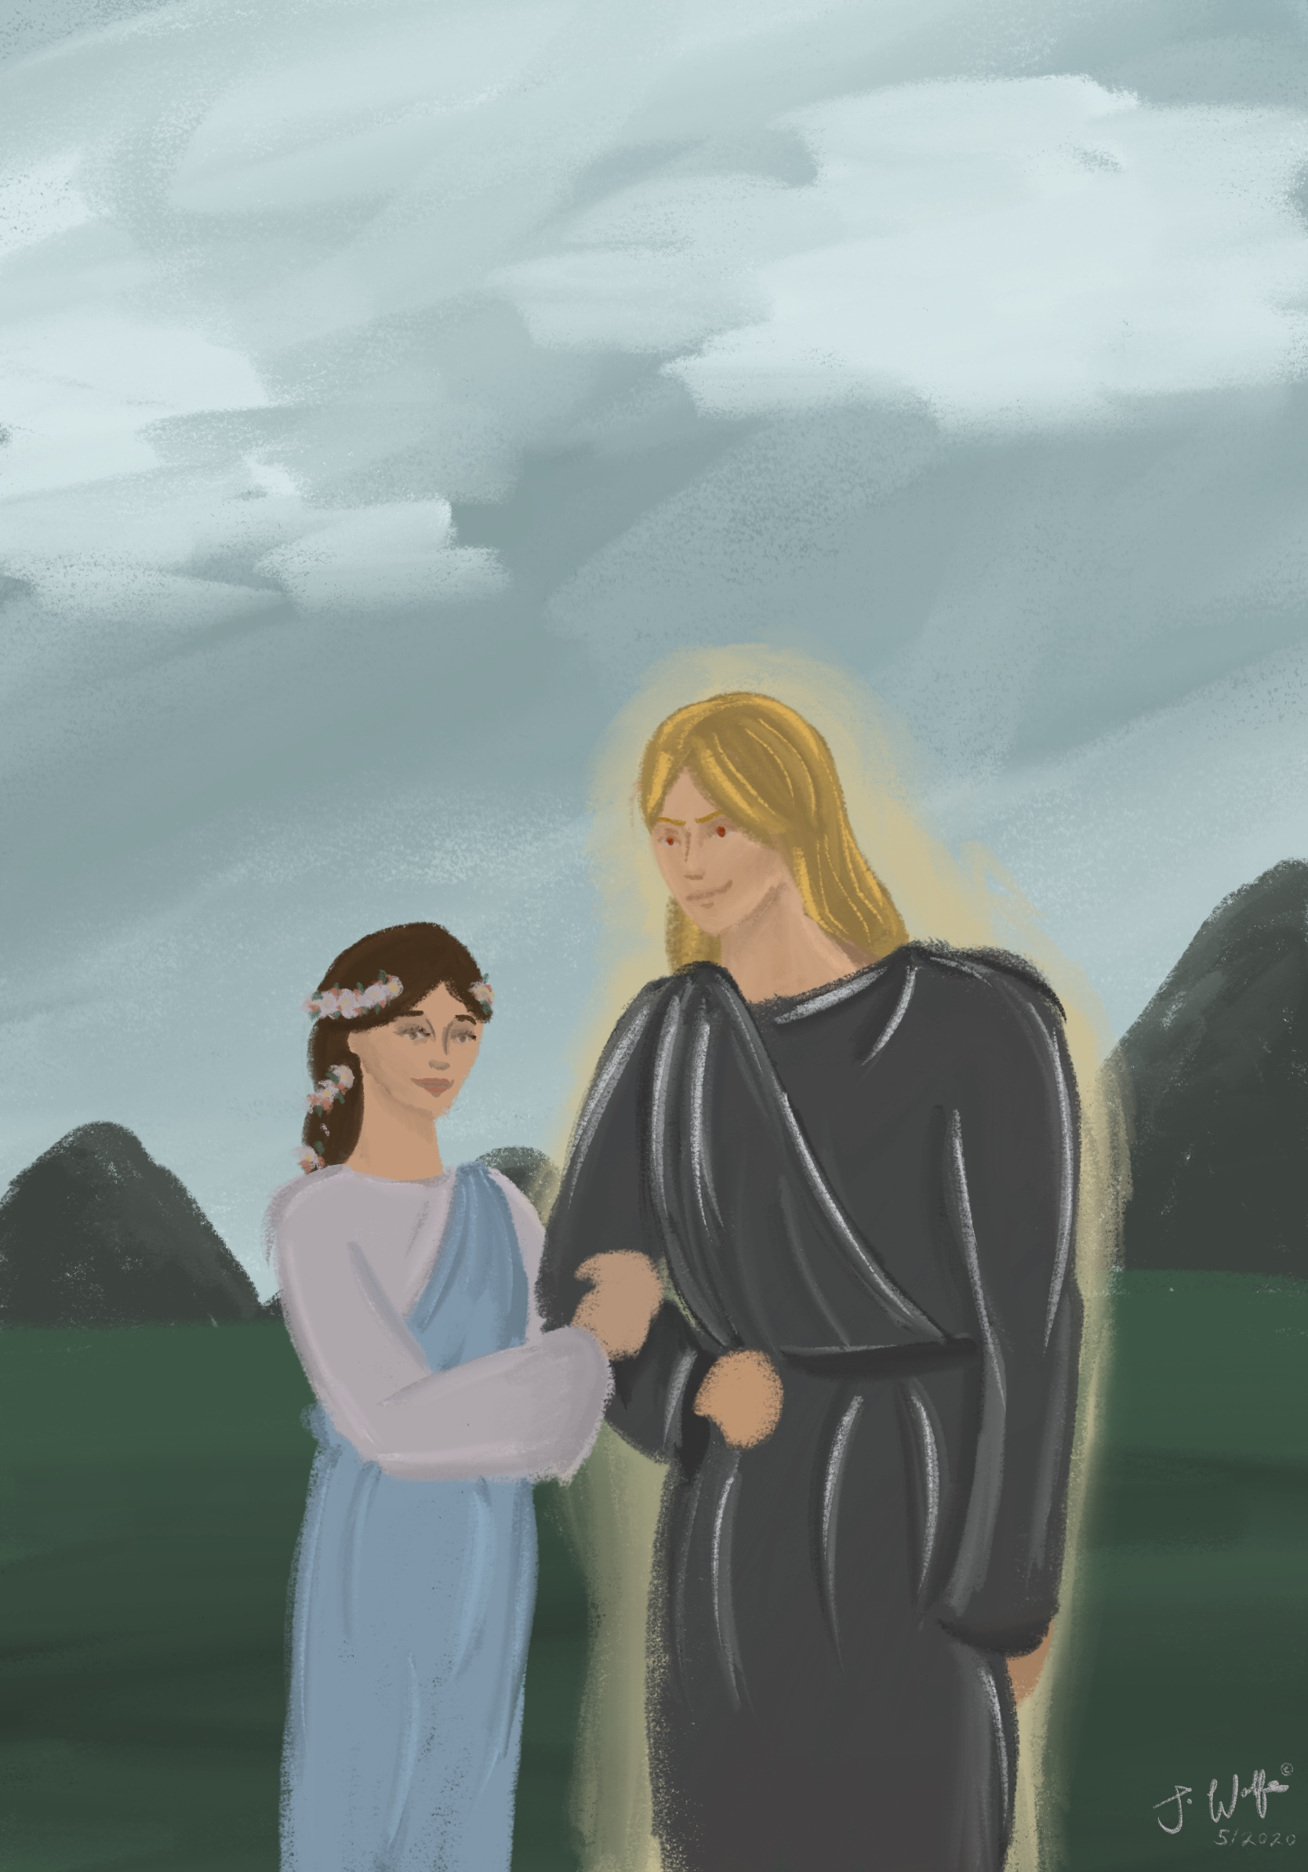

Slide 20
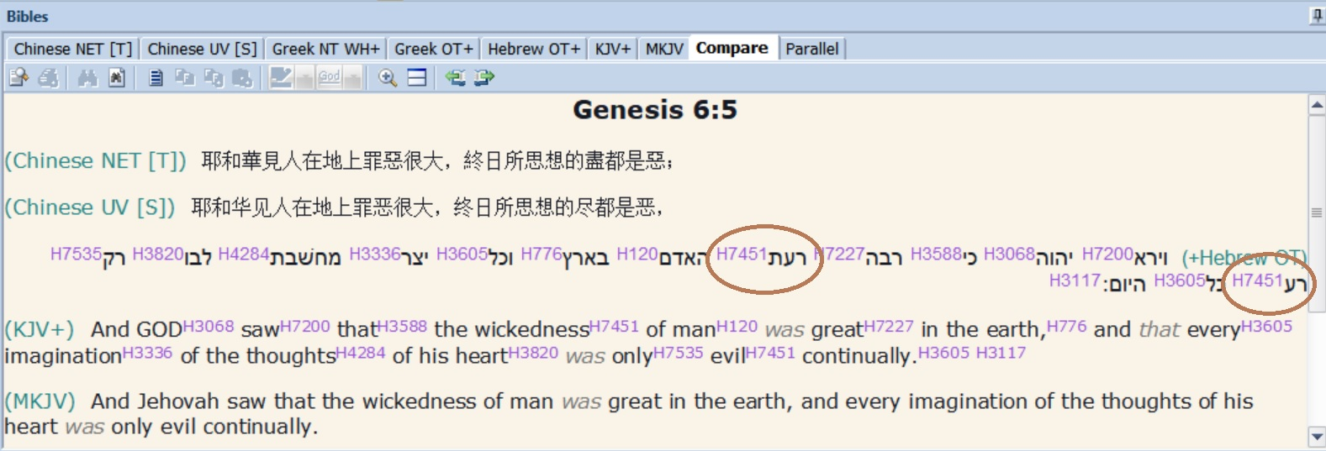
Gen 6:5
And Jehovah saw that the wickedness of man was great in the earth, and every imagination of the thoughts of his heart was only evil continually.

Slide 21
Genesis 6:6
And Jehovah repented/regretted [nacham] that He had made man on the earth, and He was angry/grieved [atsab] to His heart [lev].

Slide 22
Anthropopathism : anthropos and pathism (emotion) / Anthropomorphism : anthropos and morphism (shape)
Anthropopathism and Anthropomorphism is used in Scripture so that God can reveal his character, attributes, and policy in a way that man can understand.
“I love Jacob, I hate Esau” (Romans 9:13) / “Evil in the eyes of God”
“he created the stars with his fingers” (Ps. 8:3)

Slide 23
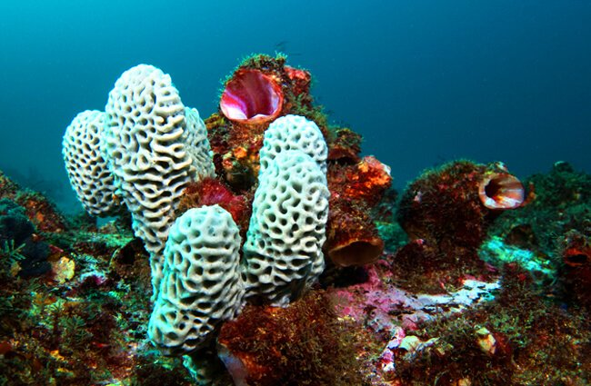
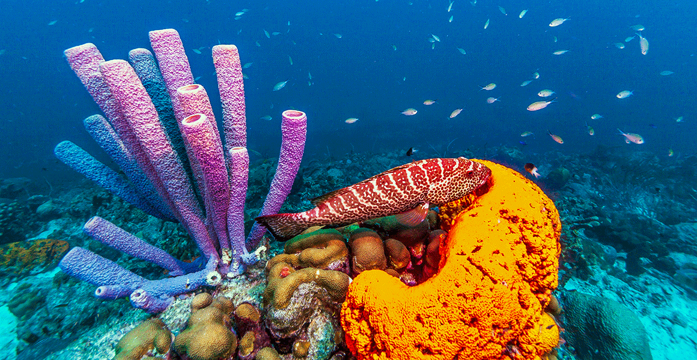
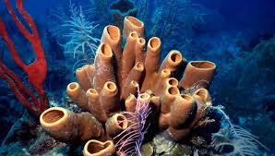

Slide 24


Spongebob Squarepants (and friends)

Slide 25
Genesis 6:6
And Jehovah repented/regretted [nacham] that He had made man on the earth, and He was angry/grieved [atsab] to His heart [lev].

Slide 26
Genesis 6:7
"And Jehovah said, I will destroy [machah = blot out, erase] man [adam, usually refering to physical humans] whom I have created [barah], from the face of the earth, both man, and beast, and the creeping thing, and the fowls of the air. For I repent [nacham] that I have made them."

Slide 27
Barah ( ארב ): To create ex-nihilo
Gen. 1:1 “In the beginning, God created [barah] the heavens and the earth.”
Gen. 1:27 'and God created [barah] man in His image' - can only refer to the soul and human spirit, not the physical human form.
Gen. 2:7 'and Jehovah God formed [yatsar] man of the dust of the ground, and breathed into his nostrils the breath of life; and man became a living soul.

Slide 28
6:7 "And Jehovah said, I will destroy [machah = blot out, erase] man [adam, usually refering to physical humans] whom I have created [barah], from the face of the earth, both man, and beast, and the creeping thing, and the fowls of the air. For I repent [nacham] that I have made them."
In this case, “repent” can be interpreted: “I have no more need of them.”

Slide 29
Genesis 6:8 But Noah found grace [chen = grace, favor] in the eyes [anthropomorphism] of Jehovah.
Noah was a believer ('found grace') and was walking in the will of God. He was therefore chosen for a great assignment, a great privilege for Noah. (1 Peter 5:5-6).

Slide 30
6:9 These are the generations of Noah. Noah was a righteous ( קידּצ tzedich ) man and perfect in his generations. Noah walked (ךלה) with God.
Righteous : could be +R (“imputed righteousness) or experiential Righteousness, depending on context. However, one cannot become experientially righteous, without first having imputed righteousness. (because salvation must come before the spiritual life can begin).

Slide 31
“Perfect in his Generations” דּור / dor (appears over 130 times in NT, emphasizing changes between one generation to the next.)
Ex 3:15” (MKJV) And God said to Moses again, You shall say this to the sons of Israel, Jehovah the God of your fathers, the God of Abraham, the God of Isaac, and the God of Jacob, has sent me to you. This is My name forever, and this is My title from generation to generation.

Slide 32
Noah : 10th in the line from Adam, a pure man, perfect flesh (Angelic conflict, Messianic line)
Genesis 3:15
(MKJV) And I will put enmity between you and the woman, and between your seed and her Seed; He will bruise your head, and you shall bruise His heel.

Slide 33
Barah ( ארב ): To create ex-nihilo
Gen. 1:1 “In the beginning, God created [barah] the heavens and the earth.”
Gen. 1:27 'and God created [barah] man in His image' - can only refer to the soul and human spirit, not the physical human form.
Gen. 2:7 'and Jehovah God formed [yatsar] man of the dust of the ground, and breathed into his nostrils the breath of life; and man became a living soul.

Slide 34
PHASE | TYPE OF RIGHTEOUSNESS | TYPE OF SANCTIFICATION
Phase One, Salvation | Imputed Righteousness (+R) : Gen. 15:6; Rom. 4:1-5) | Positional Sanctification (“in Christ” 1 Corinthians 1:2, 30)
Phase Two, The Spiritual Life | Experiential Righteousness | Experiential Sanctification (John 17:17 “sanctified by the Word of Truth.”
Phase Three, Eternity |  | Ultimate Sanctification “Blameless in the end” (1 Corinthians 1:8)

Slide 35
‘Walked with God’ this is his experiential righteousness.
Enoch ‘walked with God’ (Gen. 5:22; 24)
Examples of Walking in the spiritual life 'walking by means of the Spirit' (Gal. 5:16); 'Walking by Faith' (2 Cor. 5:17); 'Walking in Love' (Eph. 5:2); 'walking in the light' (1 Jn. 1:7); “Walking in the Lord” Colossians 2:6.
Walking is a constant process of “falling forward” - just like the double column advance we need two legs to walk, and eventually “run” to the finish line! (1 Cor. 9:24-26)

Slide 36
“Perfect in his Generations” דּור / dor (appears over 130 times in NT, emphasizing changes between one generation to the next.)
Ex 3:15” (MKJV) And God said to Moses again, You shall say this to the sons of Israel, Jehovah the God of your fathers, the God of Abraham, the God of Isaac, and the God of Jacob, has sent me to you. This is My name forever, and this is My title from generation to generation.

Slide 37
Please go to next slide show (Genesis 6:10-13)

